Slide 1
SMART TEXTILES
Presented by:
N.RAVALI
Roll no:196B1A0557

Slide 2
ABSTRACT
Smart textiles are one of the areas that provides added value to textile materials.
It is a sector that has been developed with new technologies, new fibers, and textile materials.
Smart textiles cooperate with other branches of science like nanotechnology, materials science, design, electronics, and computer engineering, etc.

Slide 3
INTRODUCTION
Textile is the basic group on which the whole fashion industry stands
Basic characteristics of clothing, protection, and fashion.
Makes our lives more simpler and efficient
Works like smart watches or smart phones
Monitors heart beat, breath rate, temperature, send messages, pickup calls etc
Development of technology and the variation requirements ,the demand to the smart textiles increasing rapidly
Applications ranging from simpler to complex

Slide 4
DEFINATION
Smart textiles are defined as the textiles that can sense and react to the environmental conditions or human body
Mostly used to monitor and provide comfort, security for its owners
Smart textiles can also be called as next-generation textiles

Slide 5
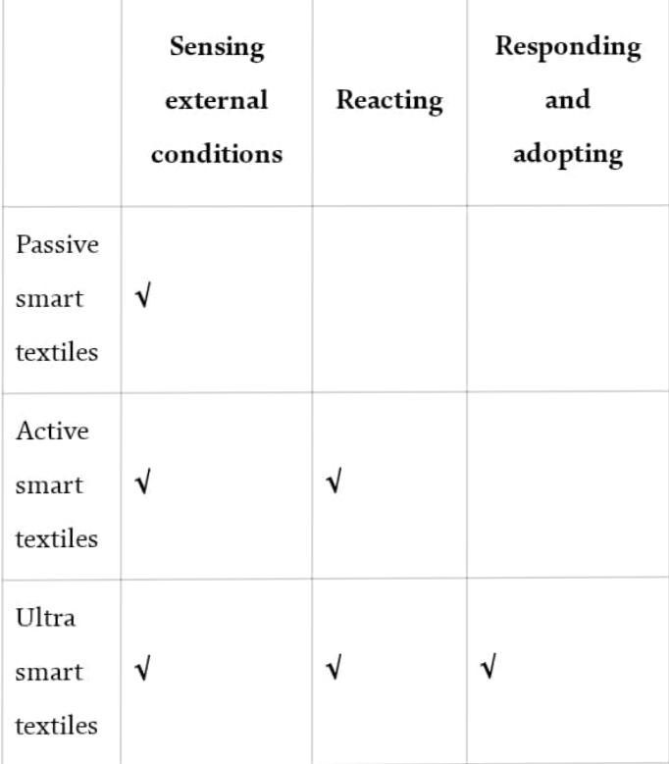
CLASSIFICATION
Smart textiles are classified based On the esthetic and performance functions are mentioned as two categories.
Esthetic smart textiles use the technology for fashion design, because of their ability to light up and change color.
As for the performance, smart textiles are classified into three categories as
PASSIVE SMART TEXTILES
ACTIVE SMART TEXTILES
ULTRA SMART TEXTILES

Slide 6
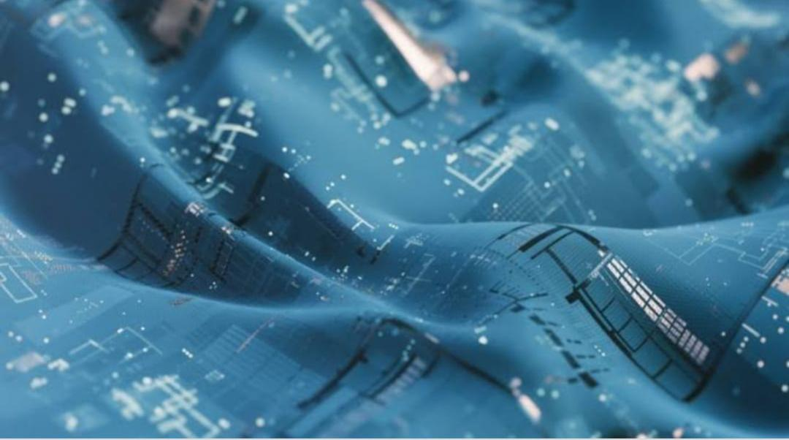
PASSIVE SMART TEXTILES
Can only sense the environment
These are sensors
Can also be knowns as first generation textiles
EX: UV protecting clothing, conductive fibers, plasma-treated clothing, and waterproof fabrics

Slide 7
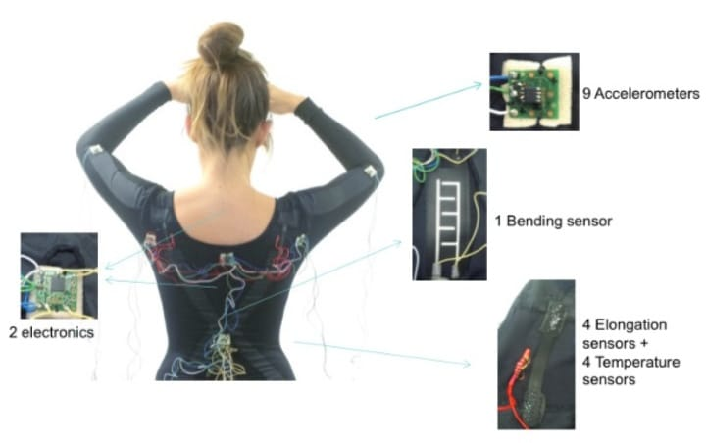
2.ACTIVE SMART TEXTILES
Can sense and react to the environmental stimuli
These are sensors and actuators
Also known as second generation textiles
Ex: Phase change materials, shape memory materials, and heat sensitive dyes

Slide 8
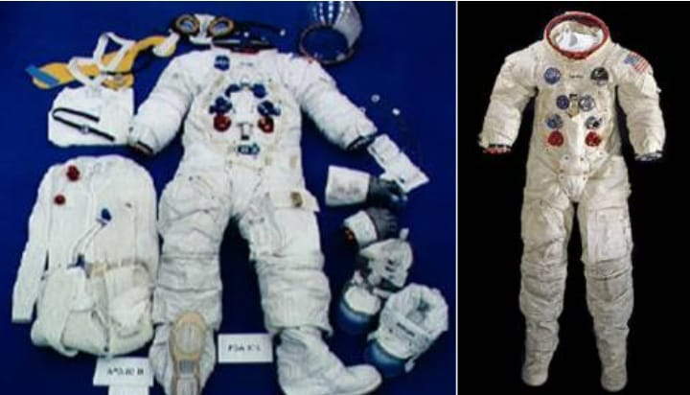
3.ULTRA SMART TEXTILES
Can sense, react and adapt themselves to environment
Consist of a unit known as micro-chip which works like brain and look like micro computer
Also known as third generation textiles
Ex: spacesuits, musical jackets, and wearable computers

Slide 9
How smart textiles works?
All smart materials involve an energy transfer from the stimuli to response given out by the material. They have the ability do some sort of processing, analyzing and responding. Even they can adapt to the environment. They can change themselves depending on temperature, pressure, density and internal energy
The amount of energy transferred to make this change is determined by the properties of the material. In technical, high performance and conventional textiles materials, state change and energy transfer is not a complicated. They just resist it or absorb it.

Slide 10
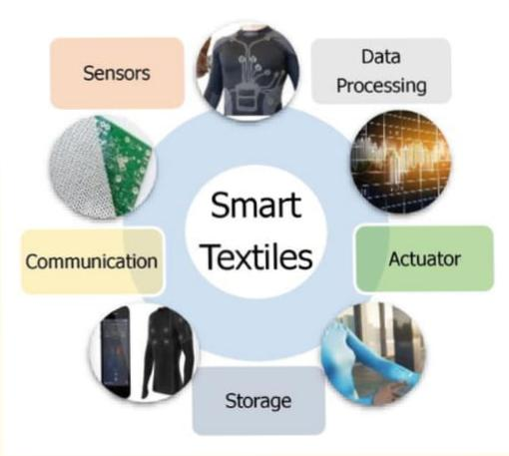
FUNCTIONS
Smart textiles consist of five functions basically.
SENSORS
DATA PROCESSING
ACTUATOR
STORAGE
COMMUNICATION

Slide 11
SENSORS
Sensors are the components that transform form one type of signal into another type of signal.
There are already systems in the smart textiles
Works with the installation of traditional sensors in textiles.
Can transfer signals in order to measure heart, breath rate, temperature
There are also different materials having the capacity of transforming signals

Slide 12
2.DATA PROCESSING
Required only when active Processing is necessary.
Necessary to process every collected information and data to obtain the desired output.
Problems encountered by data processor:
Variation of signals and analysis of signals
Energy required for the processor

Slide 13
3.ACTUATORS
Actuators are the devices designed to perform the necessary action according to signals from the sensor or processor.
Can able to do actions recommended by the sensors through data processers
Actions like moving objects, releasing materials and making noise
Ex: Shape memory material, drug supply system(emitting substances)

Slide 14
4.STORAGE
Usually Sensors, data processing, actuators, communication need energy, mostly electrical energy. For efficient energy management there should be
An appropriate combination of energy supply
Energy storage capacity. Phase change materials acts as energy storage.

Slide 15
5.COMMUNICATION
It may be required Within one element of a suit optical fibres, conductive yarns.
Between the individual elements within the suit optical fibres, conductive yarns From the wearer to the suit to pass instructions optical fibres From the suit to the wearer or his environment to pass information wireless connection i.e. antenna manufactured in textile material.

Slide 16
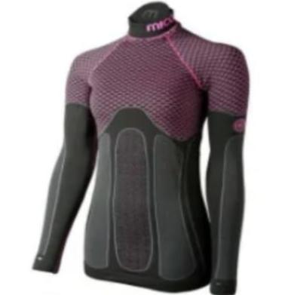
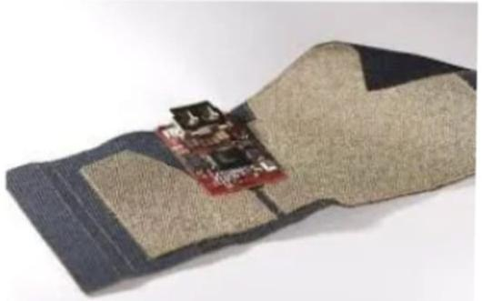
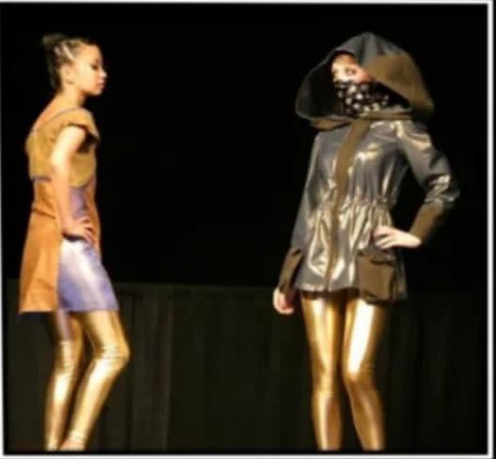
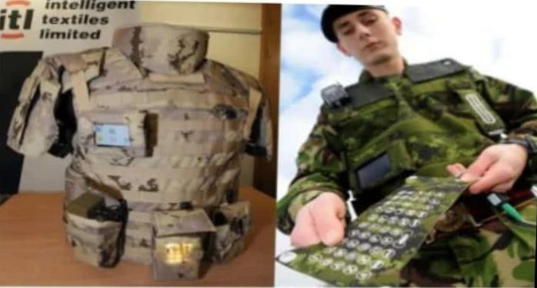
APPLICATIONS
1.Sports and human performance
2.Personalized Healthcare
3.military/security and fashion/lifestyle

Slide 17
ADVANTAGES
Built in displays
Simple Interaction with the system
Making lives simpler
Job opportunities
Development of technology
Easy to use
No compromises with the design of our costume.

Slide 18
DISADVANTAGES
Not completely waterproof They get implicated by harsh environmental conditions.
Not as flexible as normal textile clothing.
Limited reliability compare to textile clothes.
They have specific range of applications.
They have limited processing and storage capability.

Slide 19
CONCLUSION
Textiles are changing day by day and this hybridisation of textiles with other branches of science has been most welcome by all.
So, if smart textile are affordable I think they will be accepted by the user as part of his everyday life…

Slide 20


